Slide 1
Grover Search Algorithm

Slide 2
Overview

Slide 3

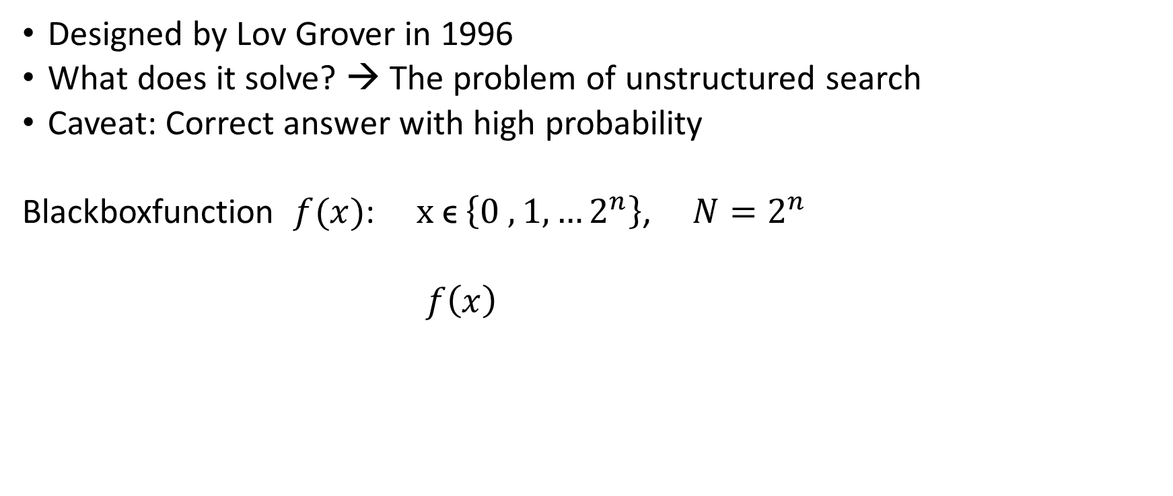


Introduction
Designed by Lov Grover in 1996
What does it solve? → The problem of unstructured search
Caveat: Correct answer with high probability
Blackboxfunction $f(x)$: $x \text{ϵ} \left\{0 ,1, …2^{n}\right\}$, ${N=2}^{n}$
$f\left(x\right)$
$$\{$$
$$0,x \text{≠} x∗$$
$$1, x=x∗$$

Slide 4
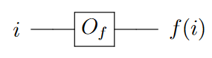
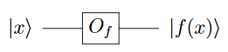
How to interact with our database?
Classical:
Medium of interaction: Oracle function
Quantum:
1:1 translation??
→ NO!

Slide 5
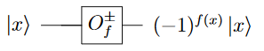
One correct oracle function:
→ Unitary and reversible

Slide 6
The Algorithm
Initialize all n qubits
Transform to uniform superposition
Query the state (Oracle)
Increase amplitude of x* (Grover diffusion operator)
Repeat (Grover Step)
Measure

Slide 7
Uniform superposition
Apply Hadamard gate and then the oracle!

Slide 8
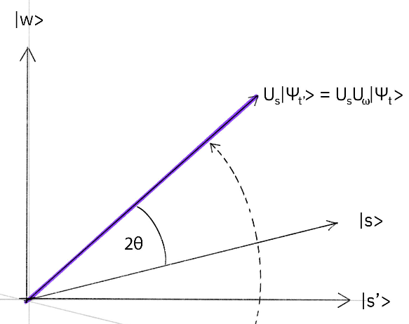
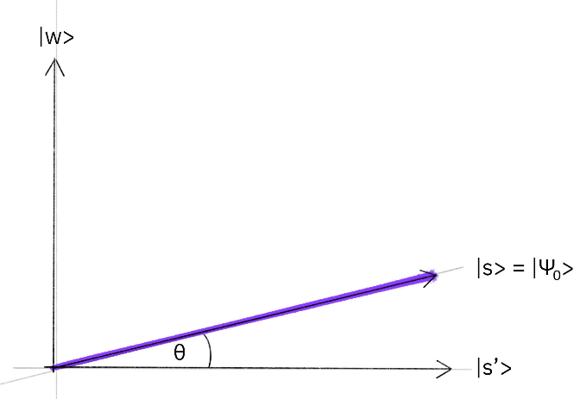
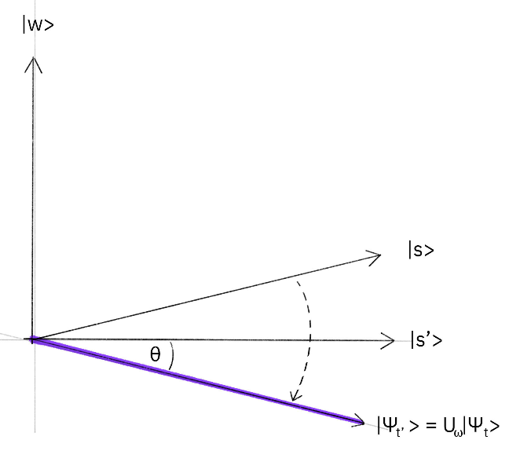
Next step
→
→
Superposition
Oracle
Diffusor

Slide 9
Grover Diffusion Operator:
Inverts x* around the average
Result: x* amplitude increases, others decrease

Slide 10
Repeat: Grover step!

Slide 11
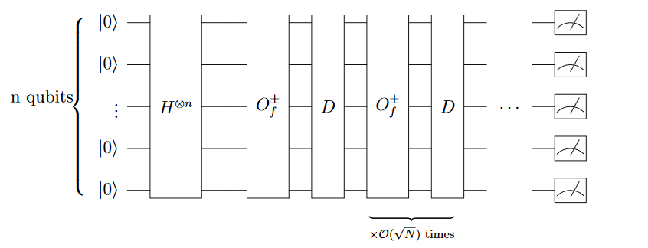
Full Algorithm:

Slide 12
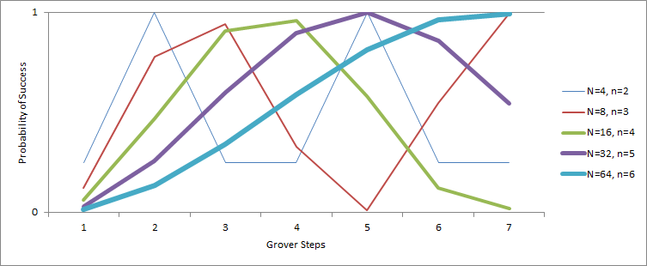

How many steps?
Best probability:
$$\frac{π}{4}√\left(N\right)$$

